Slide 1

IOT BASED GARAGE DOOR OPENER
GROUP-4

Slide 2

Interfacing Beaglebone Black with Motor Driver
Presented by- Gopikrishnan KG

Slide 3
Contents
Block Diagram
Need to Interface Beaglebone Black with Motor driver in the project
Schematic Diagram
Hardware components used
Software
Working after interfacing
References

Slide 4
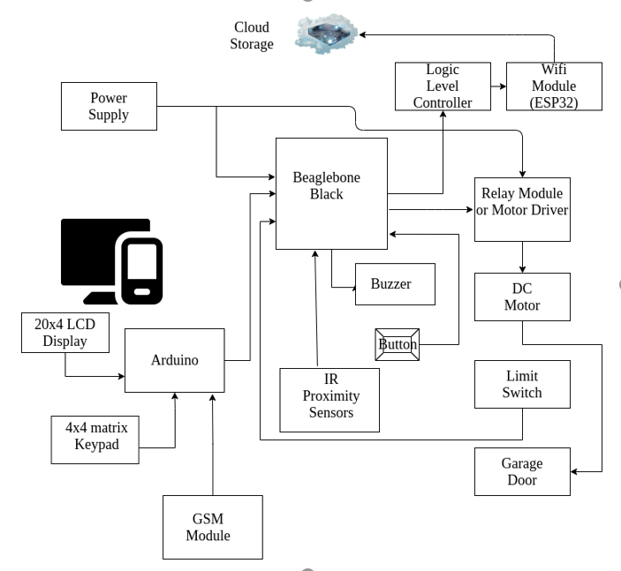
Block Diagram

Slide 5

Why to interface between Beaglebone and L298N Motor Driver?

Slide 6
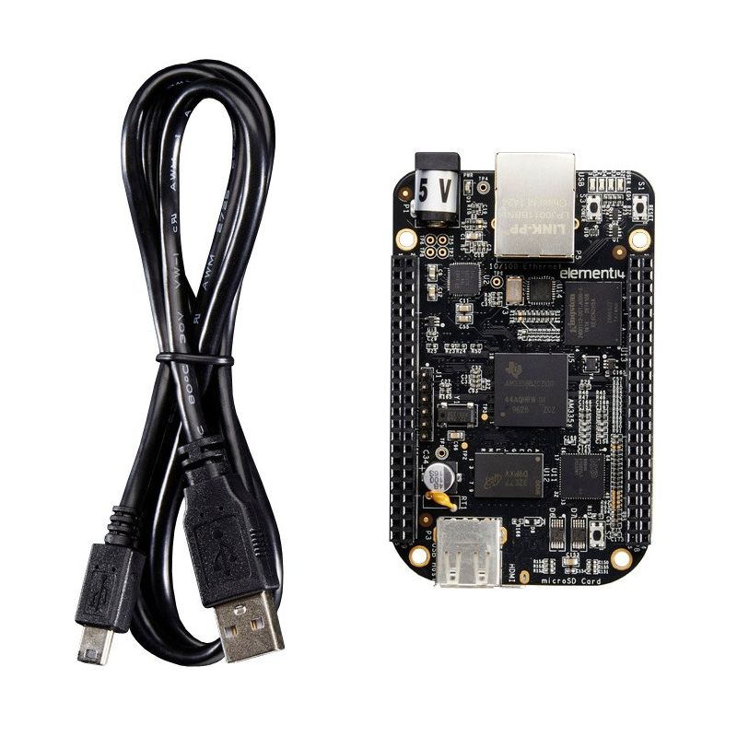
Beaglebone Black is the main microcontroller unit in the project. Interfacing of Beaglebone black to Motor Driver is critical in opening and closing of the garage door. The L298N has an H-bridge which enable the rotation of the motor in both clockwise and anti clockwise direction enabling the closing and opening of garage door.

Slide 7

Interfacing used
GPIO Interfacing

Slide 8
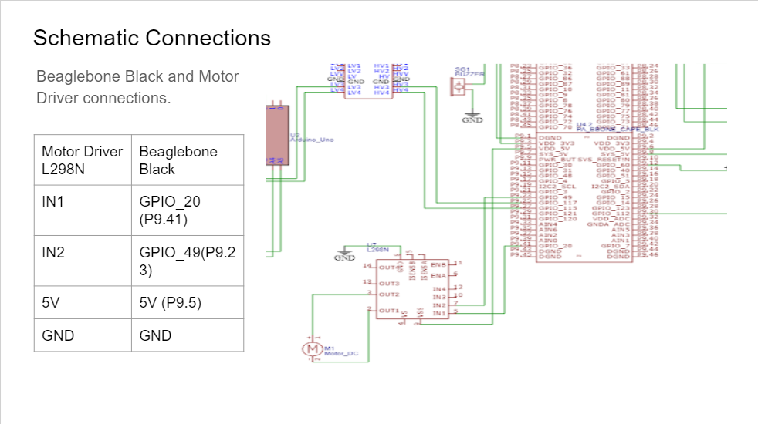
Schematic

Slide 9
Hardware components used
Beaglebone Black
L298N Motor Driver
6V DC Motor
9V Battery and Jumper wires
Host Machine and USB cable

Slide 10
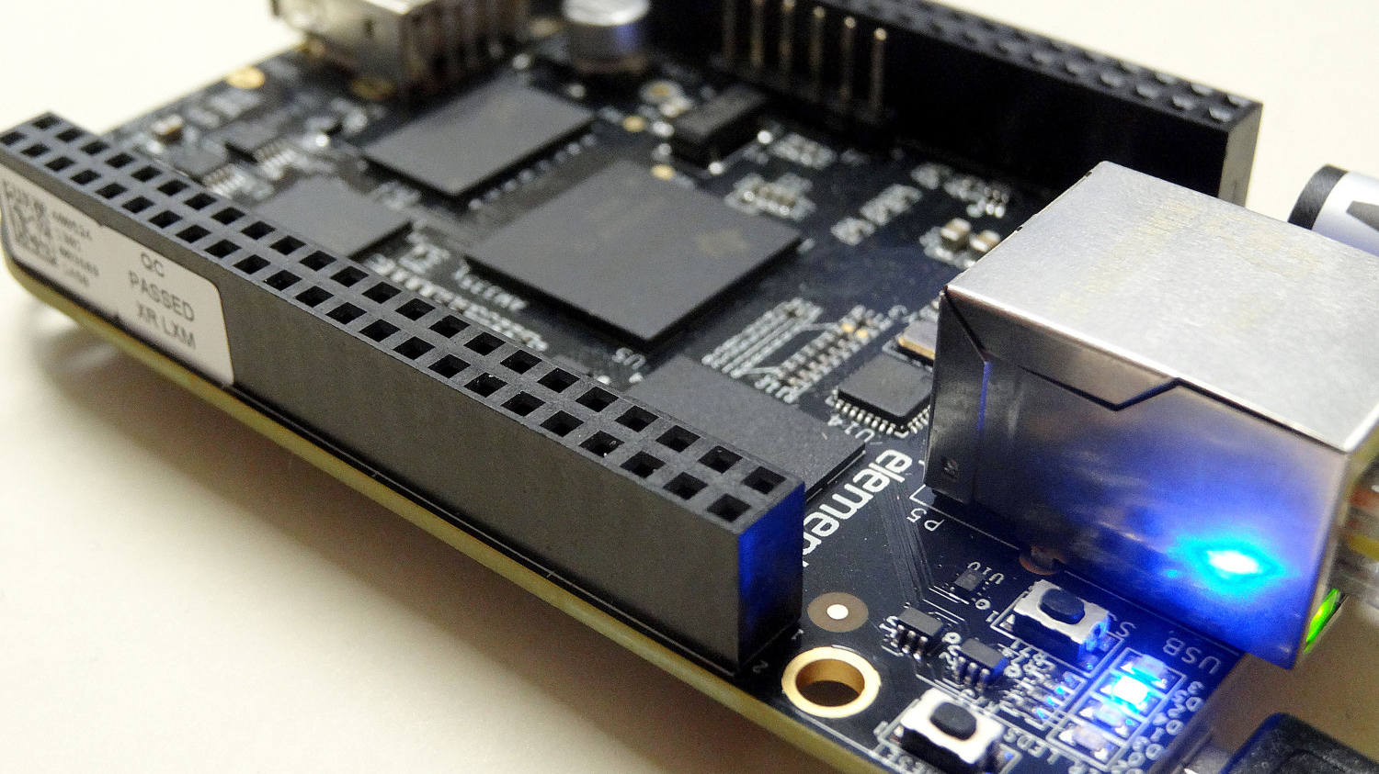
Beaglebone Black

Slide 11
Main features
Processor: Sitara AM335x 1GHz ARM® Cortex-A8
512MB DDR3 RAM
4GB 8-bit eMMC on-board flash storage
3D graphics accelerator
NEON floating point accelerator
2x PRU 32-bit microcontrollers

Slide 12
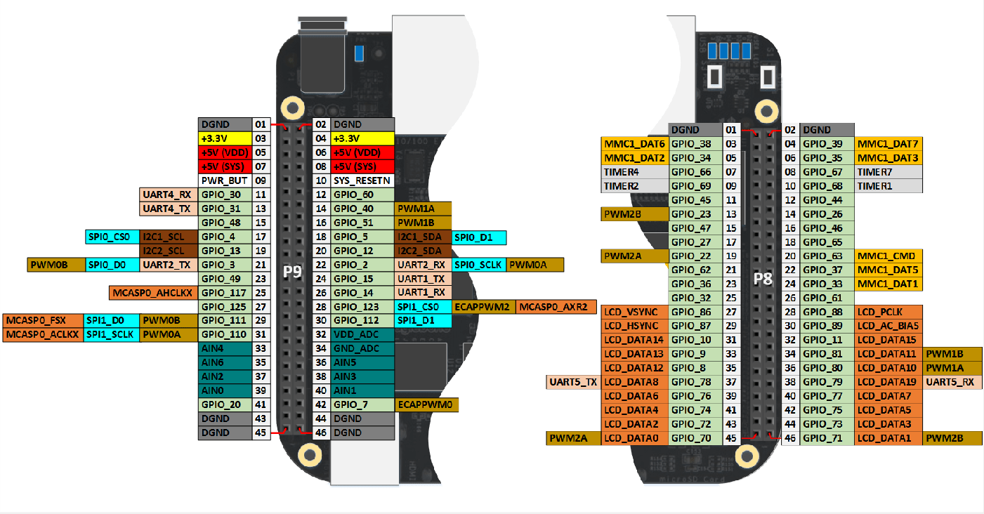
Connectivity
USB client for power & communications
USB host
Ethernet
HDMI
2x 46 pin headers

Slide 13
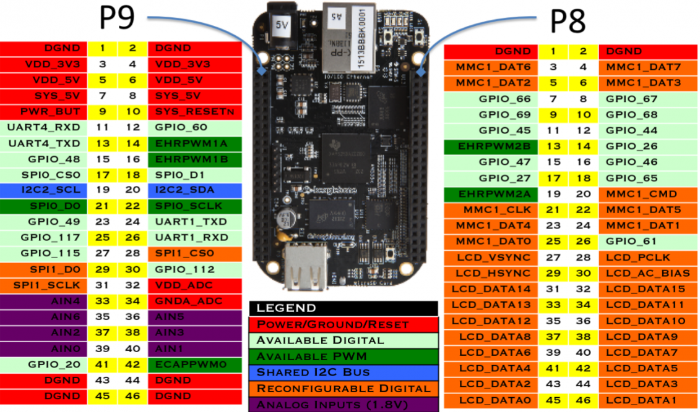
Pin Diagram
Contains 2 Pin headers P8 and P9
Contains 46 Pins in each header
Left side header is P9, and the, Right side header is P8
Pin out consist of various power source, GPIO, SPI/I2C, ADC, PWM, UART pin, LCD data and control pin etc

Slide 14
Pins used in the interfacing
DGND- The 1st pin of P9 header
VDD_5V- The 5th pin of P9 header
GPIO_49- The 23rd pin of P9 header
GPIO_20- The 41st pin of P9 header

Slide 15
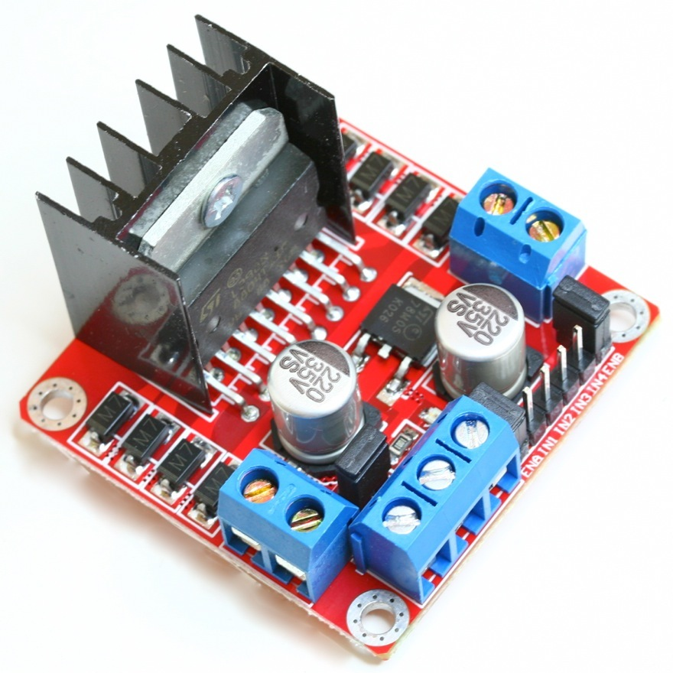
L298N Motor Driver

Slide 16
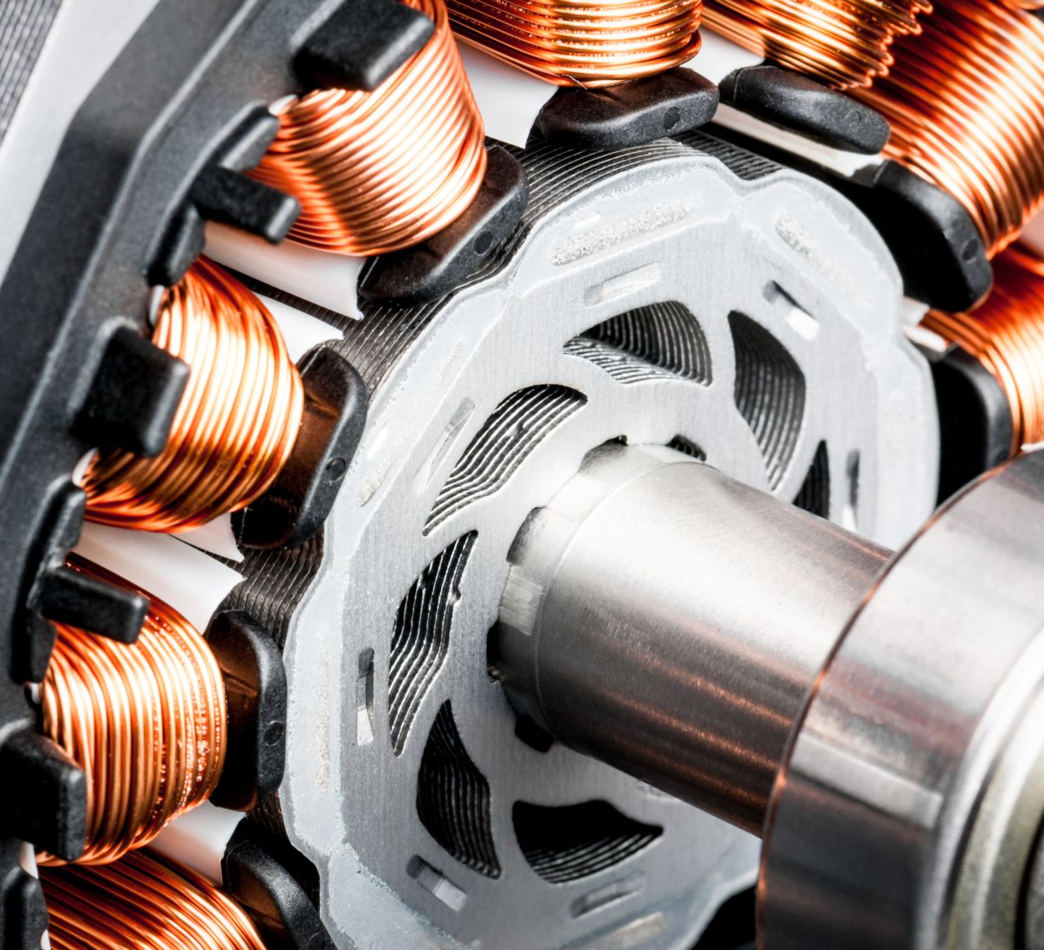
What is a Motor Driver ?
Motor drivers are circuits used to run a motor.
They are current amplifiers used to increase the magnitude of current by a fixed multiple.
Commonly used for motor interfacing
Selection depends on the motor used and its ratings.
Controller can be a microprocessor or microcontroller
Takes a low current signal and amplifies it to a high magnitude signal.

Slide 17
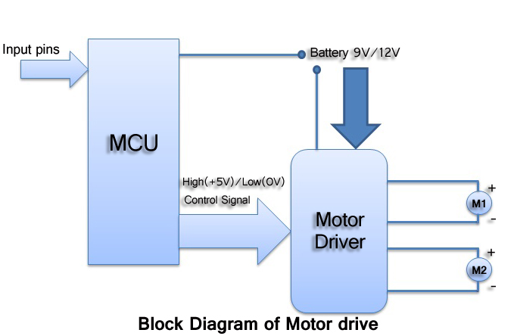
Block diagram

Slide 18
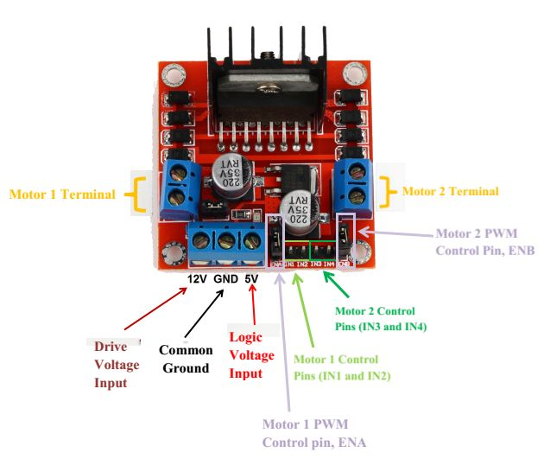
L298N Motor driver and connections
Motor Driver 12V -> Battery +
Motor Driver GND -> Battery –
Motor Driver GND -> Beaglebone DGND
Motor Driver Input 1 -> Beaglebone P9.41
Motor Driver Input 2 -> Beaglebone P9.23
Motor Wire 1 -> Motor A +
Motor Wire 2 -> Motor B +

Slide 19
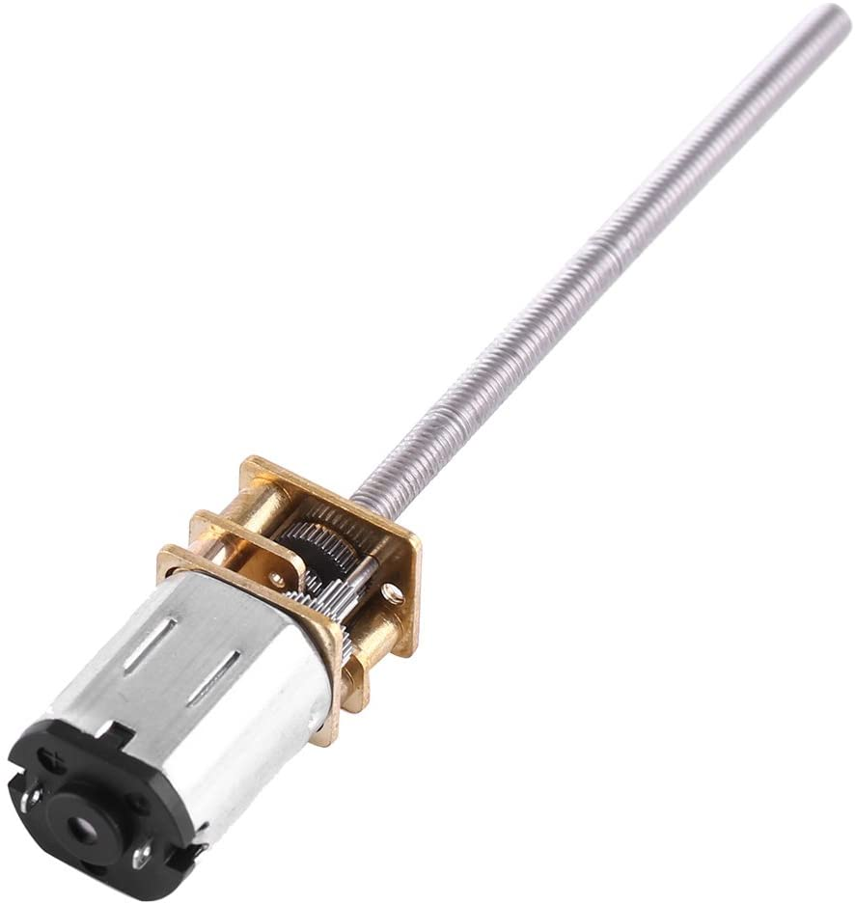
6V DC Motor
DC gearmotor has an integrated M3*55mm threaded rod as its output shaft.
Has series of gears, which in turn creates more torque.
Driver Voltage: 5-35V.
Driver Current:2A.
Maximum Motor supply current: 2A
Maximum Power (W): 25W
RPM- 150 RPM

Slide 20

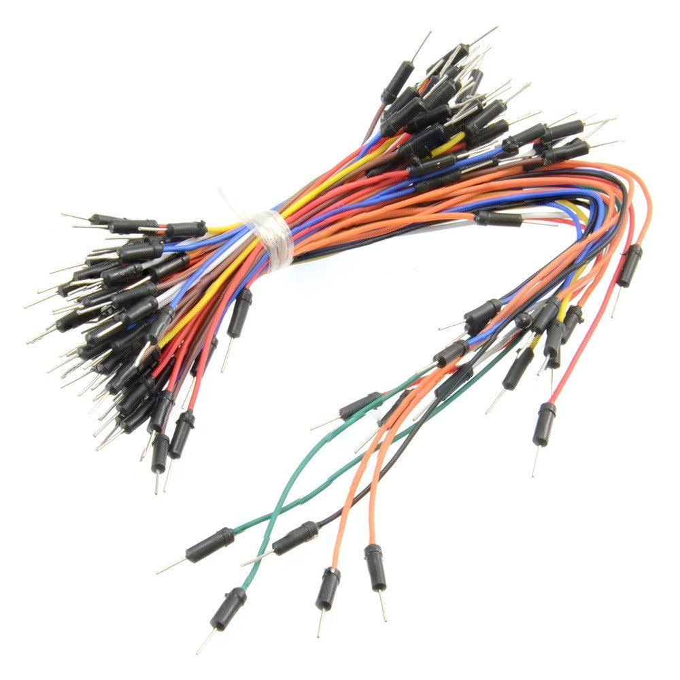
Battery and jumper wires
9V Energizer battery- To power the L298N motor driver circuit.
Jumper wires- To establish the connections between various components.

Slide 21
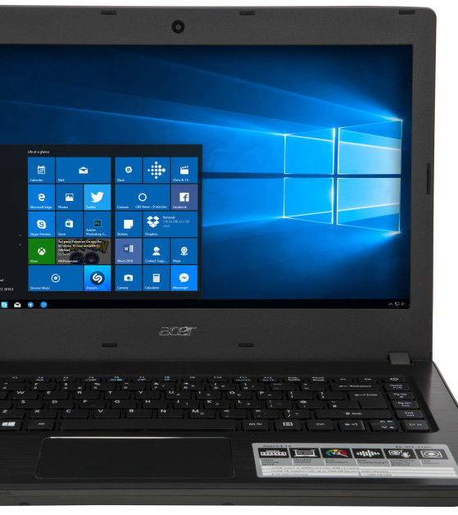
Host Machine and USB cable
Laptop- For compiling and running the code.
USB Cable- To connect the Beaglebone Black board with Host machine

Slide 22
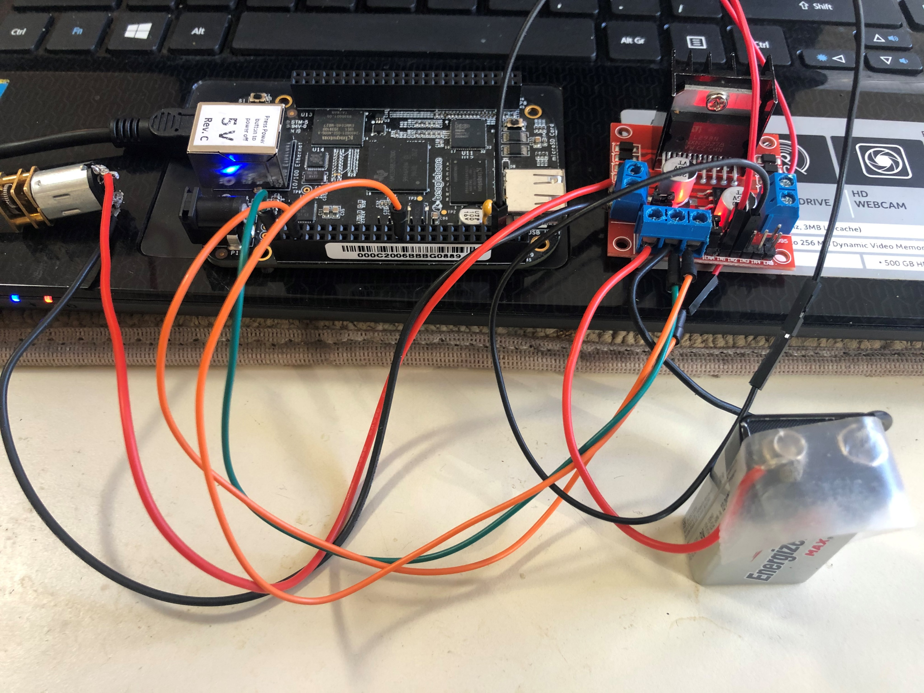

Circuit

Slide 23

Software

Slide 24

GNU Nano
Small, user-friendly console text editor.
It is a text editor Unix-like computing systems or operating environments using a command line interface.
Used for writing, compiling and executing C code essential for interfacing

Slide 25
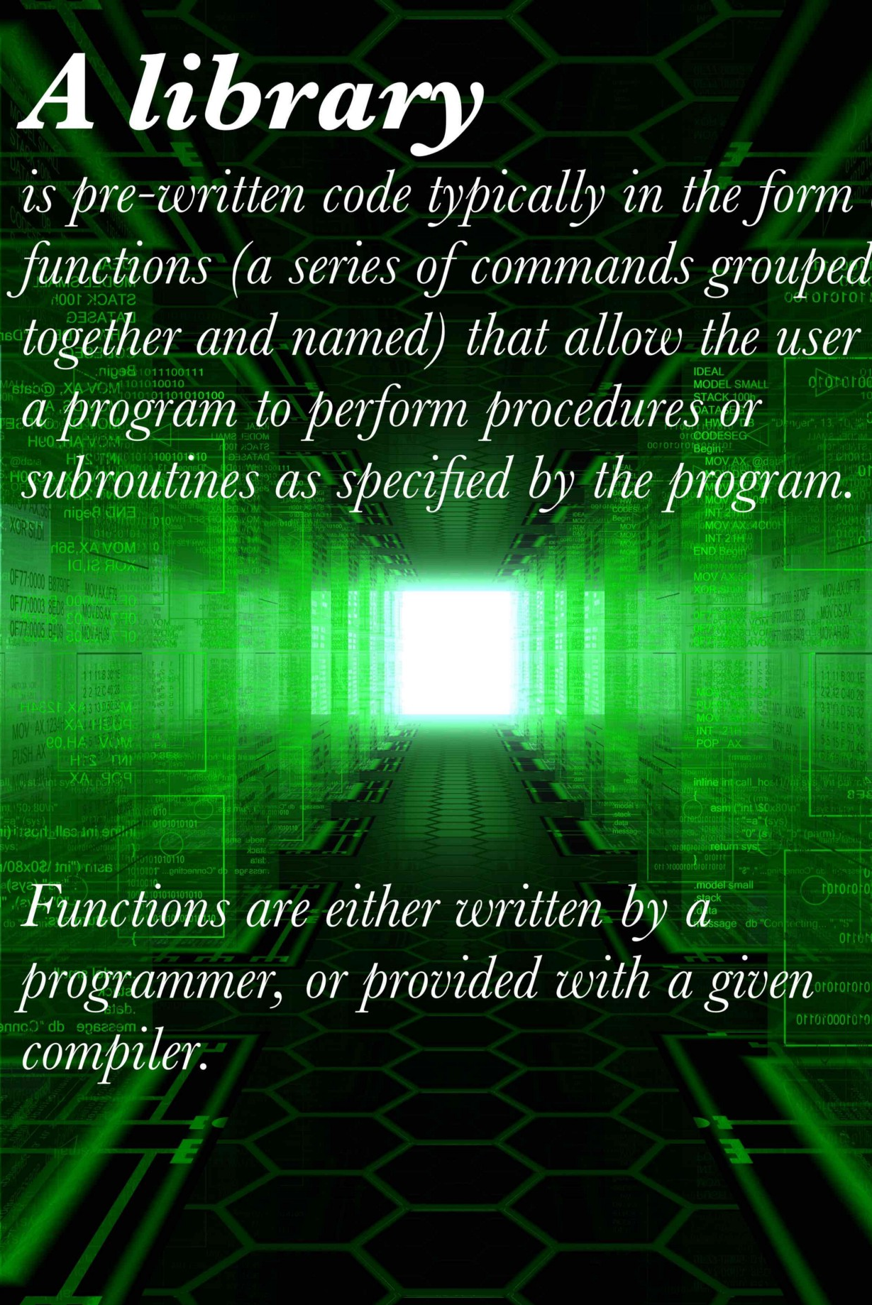
Libraries used for the interfacing
IOBB Library:
Since the interfacing of DC motor is achieved via GPIO pins this library must be used.
STDIO Library:
It is the standard C input output library
Useful for getting the input from the user and output result text to the monitor

Slide 26
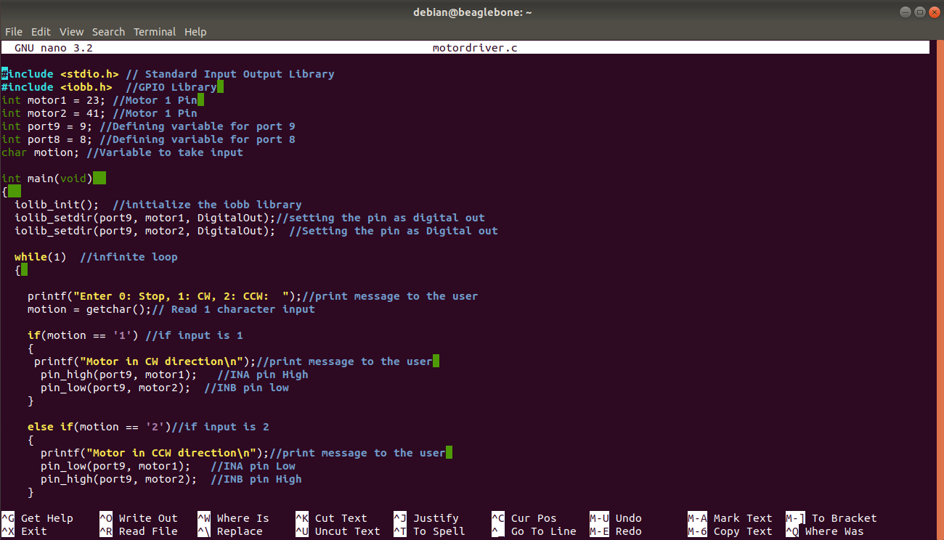
program
GPIO pins used= P9.23, P9.41.
Motion= Variable for deciding direction of rotation.

Slide 27
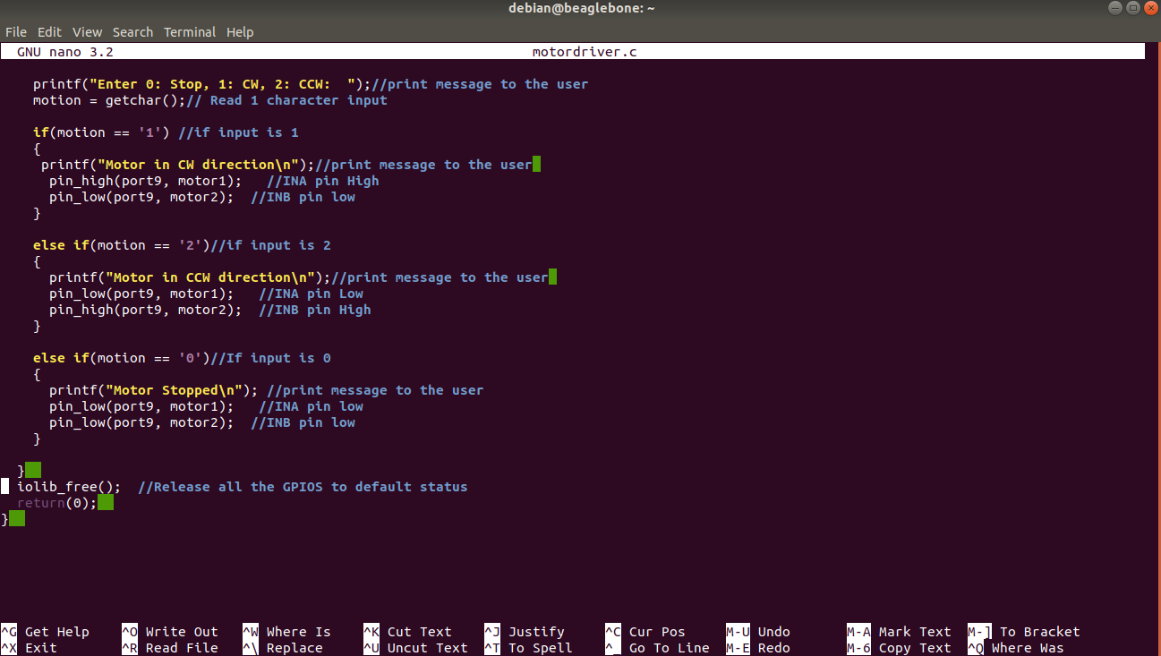
Program continued..
If Motion == 1, Clockwise direction
If Motion == 2, Counter-clockwise direction
If Motion == 0, Motor stops

Slide 28
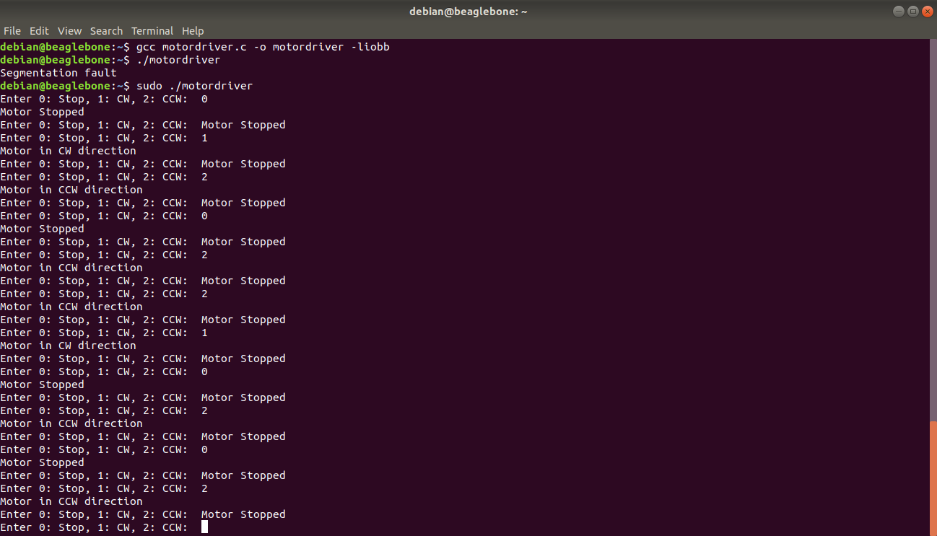
Output

Slide 29

YouTube video link
https://youtu.be/8HndIU2ff2c

Slide 30
References
Retrieved from engineersgarage.com, Getting started with Beaglebone black(2020, October 1) URL:https://www.engineersgarage.com/electronic-projects/getting-started-with-beaglebone-black-part-1-15/
Retrieved from meptis.com, DC Motor circuit. URL: https://www.mepits.com/tutorial/379/electrical/motor-driver
Retrieved from Components101.com, L298N Motor Driver(2020, April 13). URL:https://components101.com/modules/l293n-motor-driver-module
Retrieved from amazon.ca ,DC 6V Gear motor. URL:https://www.amazon.ca/gp/product/B07558R8QW/ref=ppx_yo_dt_b_asin_image_o02_s00?ie=UTF8&psc=1
Retrieved from element14.com, Beagle Board (2019,August 14). URL: BeagleBone Black (BBB) and PocketBeagle I/O (GPIO), SPI and I2C Library for C – 2019 Edition

Slide 31
References
Retrieved from engineersgarage.com, DC motor interfacing with Beaglebone black( 2016, July 16). URL: https://www.engineersgarage.com/tutorials/dc-motor-interfacing-with-beaglebone-black/
Retrieved from Beagleboard.org, Beagleboard Black and L298N Motor Driver in Python(2018, May 6). URL:https://beagleboard.org/p/silver2row/beaglebone-black-and-l298-motor-driver-in-python-2156be
Retrieved from Beaglebone.org. URL:http://beagleboard.org/black
Retrieved from microcontrollerslab.com, BeagleBone Black Pinout, Pin configuration and features. URL:https://microcontrollerslab.com/beaglebone-black-pinout-pin-configuration-features-applications/
Retrieved from linuxhint.com, How to Use the Nano Text Editor. URL:https://linuxhint.com/gnu_nano_editor/

Slide 32
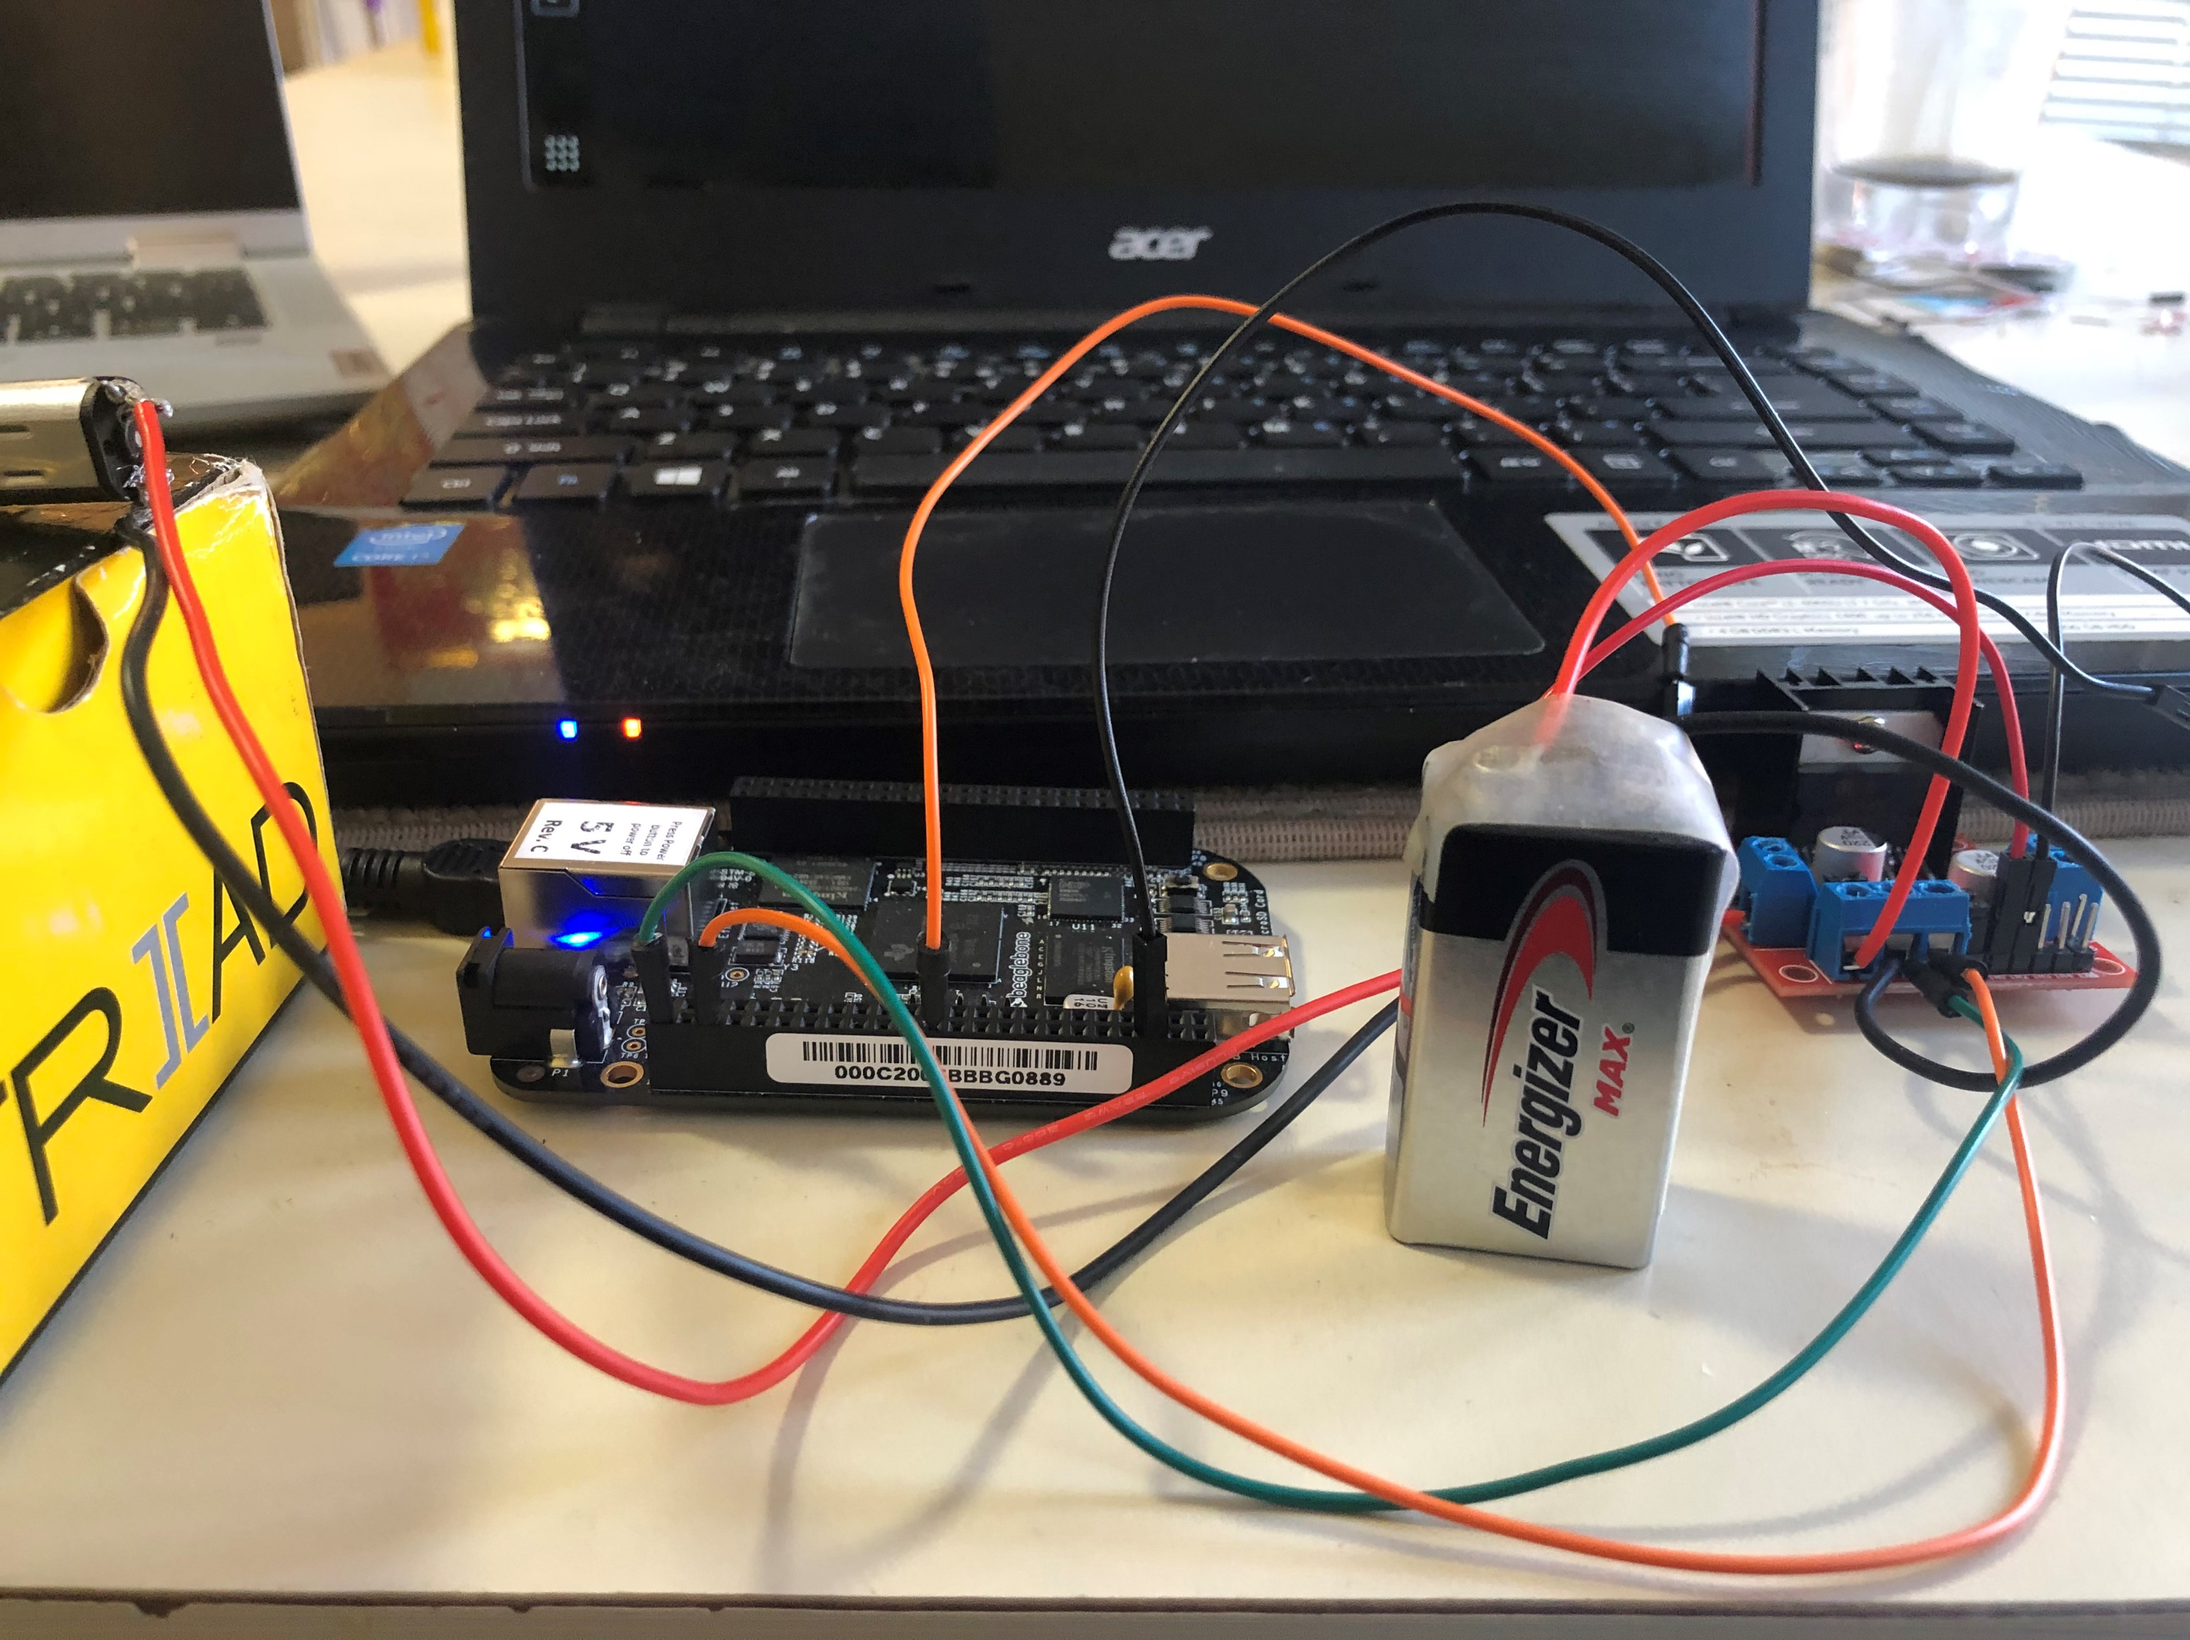

Thank You

